Slide 1
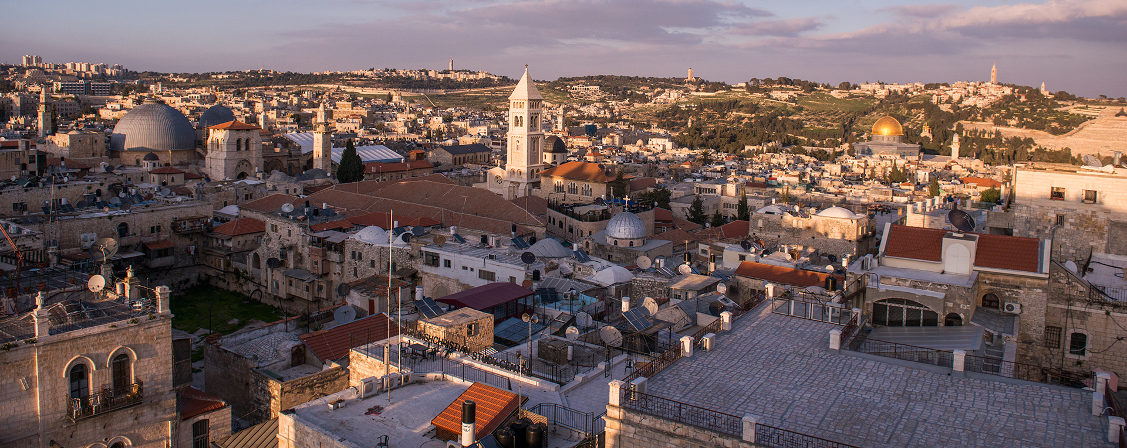
Coburg Road Church of Christ - January 13, 2019
Jerusalem - Looking North & East from “Citadel of David” Tower

Slide 2
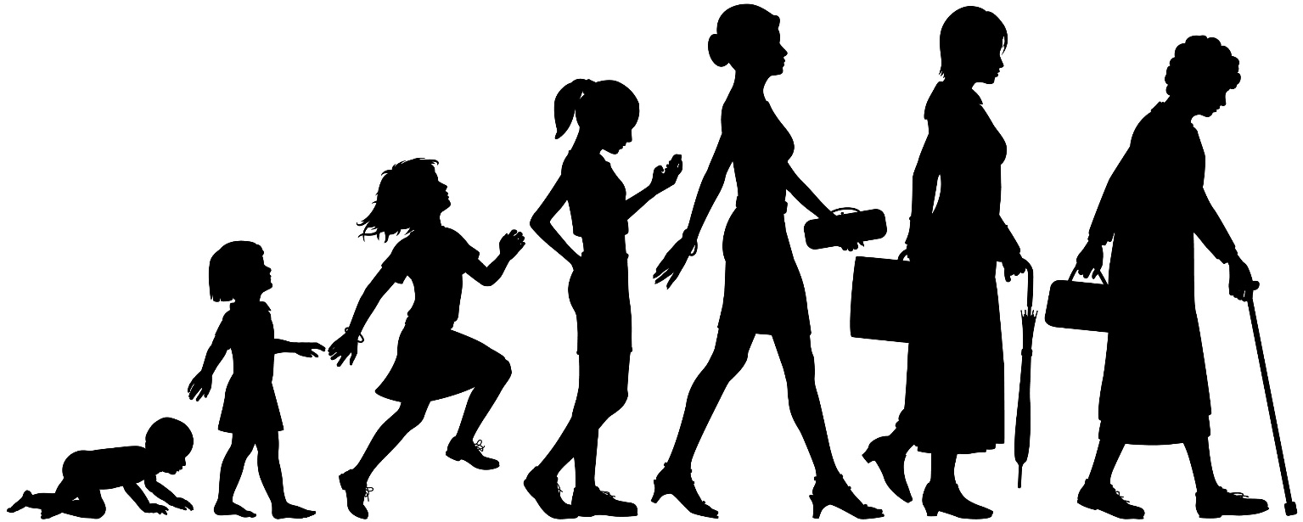

Stages Of
Human Growth
All Stages
Are Necessary

Slide 3

Ephesians 4:11-16
Colossians 1:9-12
1 Thessalonians 3:11 - 4:1
1 Peter 1:22 - 2:3
2 Peter 1:5-11, 3:17f

